Slide 1
Introductory General Chemistry
Chemistry 3A
S. M. Halloran

Slide 2
Acids and Bases
Acids
Specific Acids
Bases
Specific Bases
Definition of Acid, Base
- Bronsted-Lowry
Hydronium Ion
Conjugate Acid-Base Pair
Reactions
- Neutralization
- With Active Metals
Strong and Weak Acids & Bases
Water Equilibrium Constant, Kw
pH scale and math of pH
pOH
Buffers

Slide 3
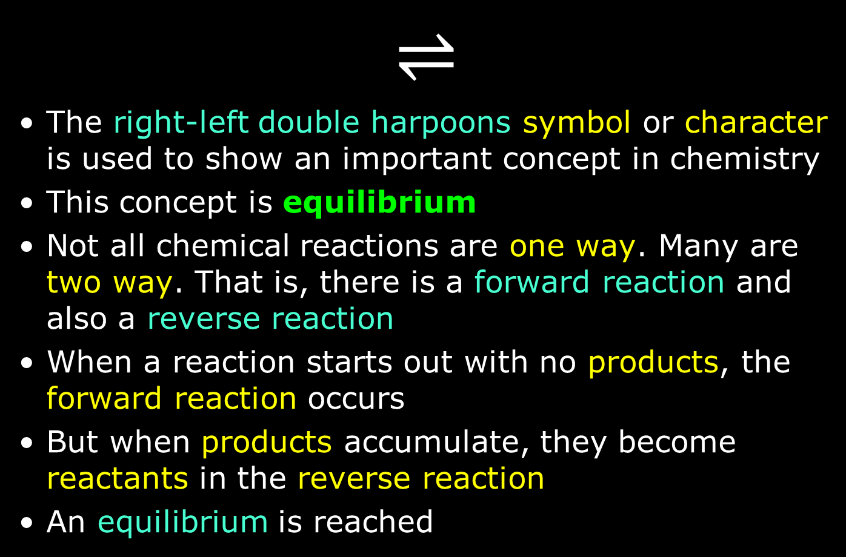
The Equilibrium Symbol/Character
$$⇌$$
The right-left double harpoons symbol or character is used to show an important concept in chemistry
This concept is equilibrium
Not all chemical reactions are one way. Many are two way. That is, there is a forward reaction and also a reverse reaction
When a reaction starts out with no products, the forward reaction occurs
But when products accumulate, they become reactants in the reverse reaction
An equilibrium is reached

Slide 4
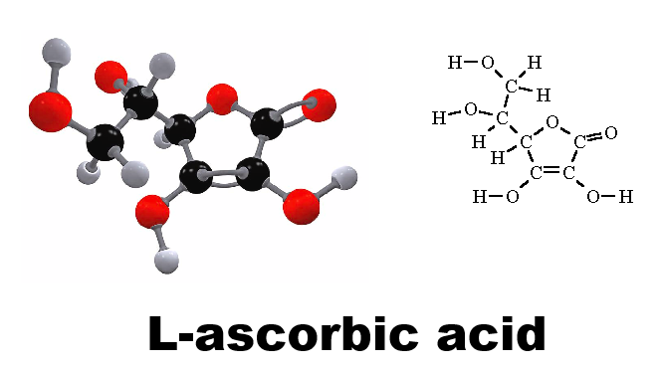
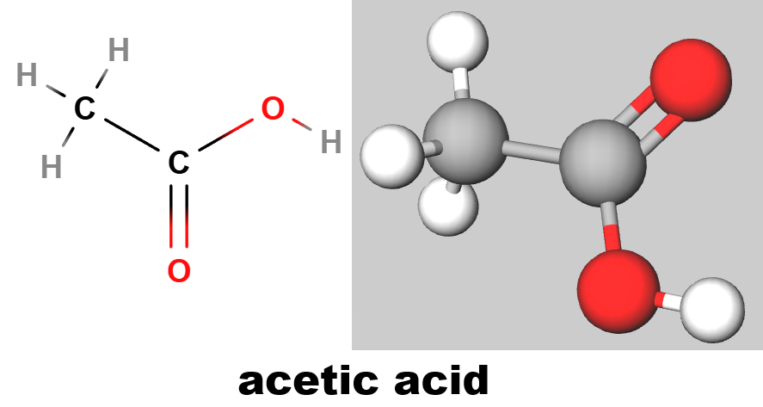
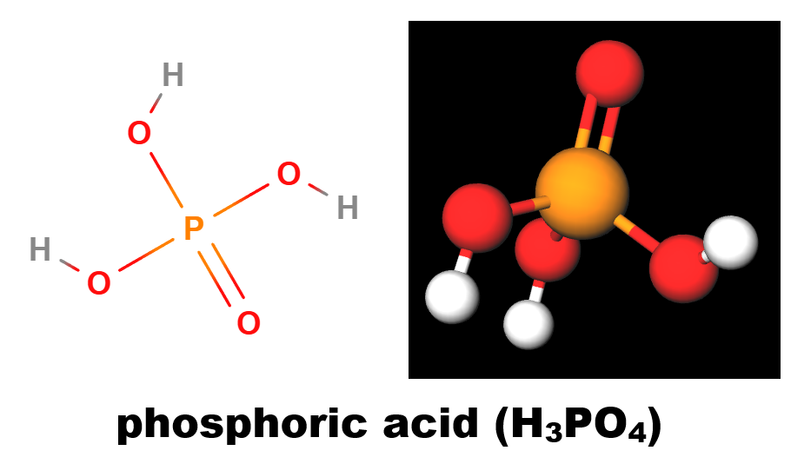
Acids
Foods
Citrus: oranges, lemons
Compounds: citric acid, L-ascorbic acid (Vitamin C), phosphoric acid (soft drinks), acetic acid (vinegar), hydrochloric acid (stomach acid)

Slide 5
Acids
The protic kind of acids release hydrogen ions (H⁺)
Hydrogen ions are actually protons, so you will hear the word proton used in reference to acids
Acids are electrolytes: conduct electrical current
Strong acids: (nearly) complete (100%) ionization
Weak acids: moderately weak 10-99% ionization
Very weak acids: < 10% ionization
Sour taste
Blue litmus → red, phenolphthalein → colorless
React with active metals → hydrogen gas (H₂)
Neutralization: react with bases → salt + water

Slide 6
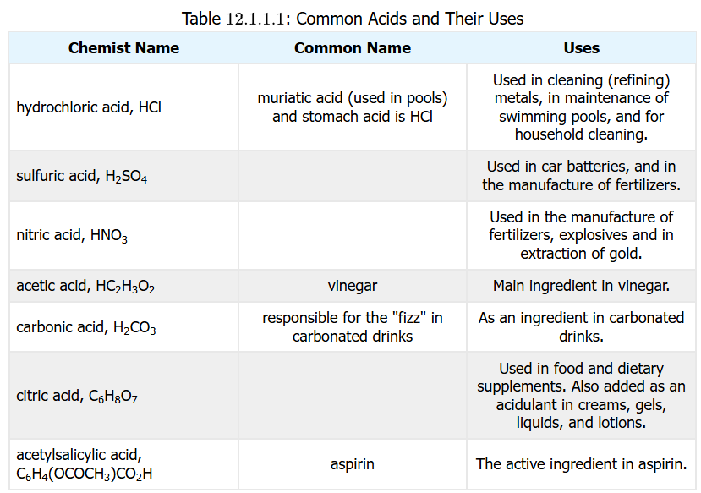

Slide 7
Specific Acids
Hydrochloric acid (HCl)
HCl (g) + H₂O (l) → H₃O⁺ (aq) + Cl– (aq)
a STRONG acid
Often used is titration
Sulfuric acid (H₂SO₄)
H₂SO₄ (aq) + H₂O (l) → H₃O⁺ (aq) + HSO₄– (aq)
HSO₄– (aq) + H₂O (l) → H₃O⁺ (aq) + SO₄^{2–} (aq)
another strong and diprotic acid
strongly dehydrating
Diprotic – releases two H+ ions in solvent
Monoprotic – releases one H+ ion in solvent
H₂SO₄ is the strong acid, but HSO₄– actually a weak acid

Slide 8
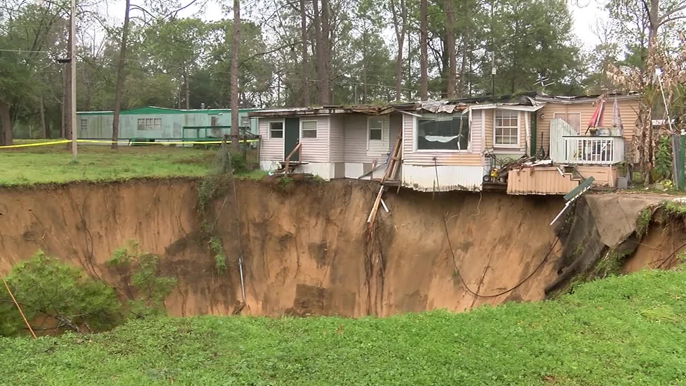
Specific Acids
Nitric acid (HNO₃)
Production: 3 NO₂ (g) + H₂O (l) → 2 HNO₃ (aq) + NO (g)
strong corrosive mineral acid
Reactive with metals Mn, Mg, Zn
metal + 2 HNO₃ → metal(NO₃)₂ + H₂ (g)
Carbonic acid (H₂CO₃)
a weak diprotic acid that can form carbonates (CO₃^{2–}) and bicarbonates (HCO₃–)
It is an inorganic, not organic (carboxylic) acid
Found in carbonated beverages
Dissolves limestone (to Ca(HCO₃)₂)

Slide 9
Specific Acids
Phosphoric acid (H₃PO₄)
a weak acid
it has three acidic protons (sulfuric acid has two)
it is a triprotic acid
acids with multiple acidic hydrogen atoms (protons) can be called polyprotic
it is a very good buffering compound: it controls changes in pH of aqueous solutions

Slide 10
Specific Acids
Formic acid (HCOOH)
simplest of organic (carboxylic) acids
an acid strongly associated with ants
Citric acid (C₆H₈O₇)
weak tricarboxylic acid in citrus fruits
At the start of the tricarboxylic acid cycle (also called Krebs cycle, and citric acid cycle)
Acetylsalicylic acid (aspirin)
effective anti-inflammatory agent (fever, pain)

Slide 11
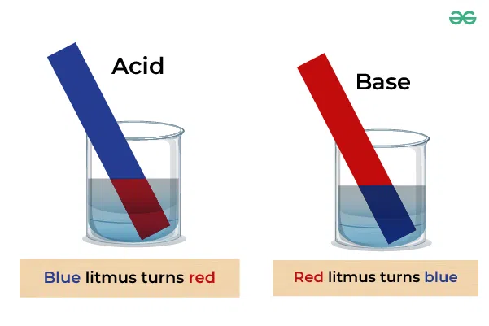
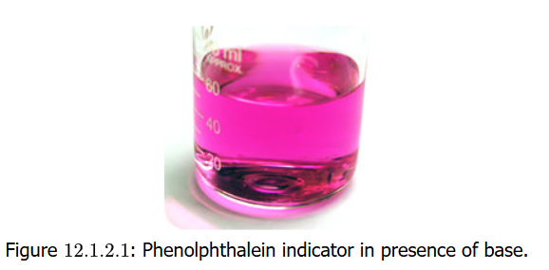
Bases
Bases often generate hydroxyl ions (OH–)
Like acids, they are electrolytes
There are Strong and Weak bases
Usually have a bitter taste, not typical in foods
Red litmus → blue, phenolphthalein → pink
Not reactive with metals like acids
Neutralization: react with acids → salt + water

Slide 12
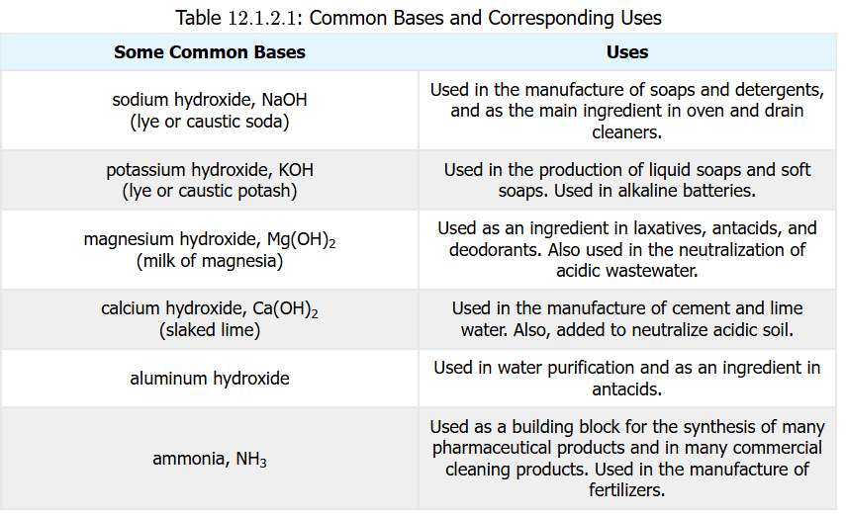

Slide 13
Specific Bases
Sodium Hydroxide (NaOH)
NaOH (s) → Na⁺ (aq) + OH– (aq)
a STRONG base: called lye and caustic soda
Dissolution quite exothermic (heat-releasing)
Often used is titration; feels slippery to skin
Potassium Hydroxide (KOH)
KOH (s) → K⁺ (aq) + OH– (aq)
another strong base: caustic potash
Also exothermic on dissolution

Slide 14
Specific Bases
Magnesium Hydroxide [Mg(OH)₂]
Mg(OH)₂ (s) → Mg²⁺ (aq) + 2 OH– (aq)
Common in antacids and laxatives
White solid with low aqueous solubility
Calcium Hydroxide [Ca(OH)₂]
Ca(OH)₂ (s) → Ca²⁺ (aq) + 2 OH– (aq)
“slaked lime” colorless crystal or white powder
relatively insoluble in water

Slide 15
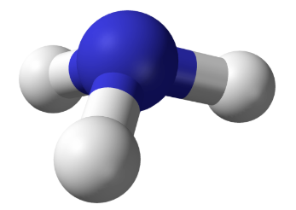

Specific Bases
Ammonia (NH₃)
NH₃ (g) + H₂O (l) $⇌$ NH₄⁺ (aq) + OH– (aq)
colorless gas with pungent smell
Many applications, including cleaning solutions
The “ammonia” sold in stores is really ammonium hydroxide (ammonia dissolved in water)

Slide 16
What Defines An Acid, A Base?
Arrhenius Theory of Acids/Bases
1884: Arrhenius proposes acid increases H⁺ ions as hydronium (H₃O⁺) ion concentration in aqueous solvent, base increase OH– ions
HCl (aq) + H₂O (l) → H₃O⁺ (aq) + Cl– (aq)
NaOH (aq) → Na⁺ (aq) + OH– (aq)
Limitations
Does not explain how ammonia NH₃ achieves this
Does not explain alkalinity in non-aqueous solutions

Slide 17
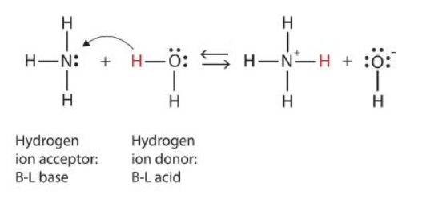
What Defines An Acid, A Base?
Bronsted-Lowry Theory of Acids/Bases
1923: Dane Bronsted and Englishman Lowry propose an acid is a substance that donates a proton (H⁺) ion to a molecule and a base accepts a proton. This now explains ammonia as a base:
NH₃ (aq) + H₂O (l) → NH₄⁺ (aq) + OH– (aq)

Slide 18
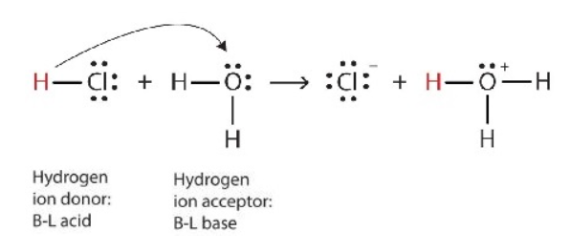
The Hydronium Ion (H₃O⁺)
An acid can yield a hydrogen ion (H⁺), a proton, but that does move about alone in water
HCl will ionize to H⁺ and Cl– particularly in water (aqueous solution), but what really happens is that it transfers H⁺ (the proton) to H₂O, which actually acts as a (weak) base (proton acceptor)

Slide 19
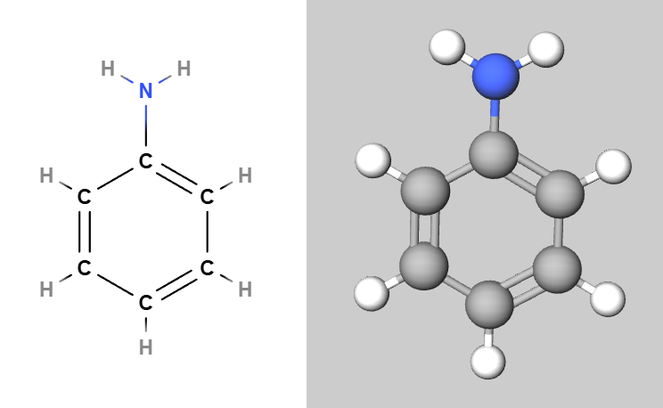

Practice: Definitions of Acids/Bases
Aniline (C₆H₅NH₂) soluble in water. Its nitrogen atom accepts H⁺ ion from a water molecule, as nitrogen in ammonia. What is the equation for reaction and what is the acid and what is the base?
C₆H₅NH₂ (aq) + H₂O (l) $⇌$ C₆H₅NH₃⁺ (aq) + OH– (aq)
Aniline is basically ammonia, which we know is a base, but with just one of the H atoms replaced with a benzyl function. So aniline is the base. It is reacting with water, which can function as a very weak acid or base. Note the products are an anilinium ion and a hydroxyl ion

Slide 20
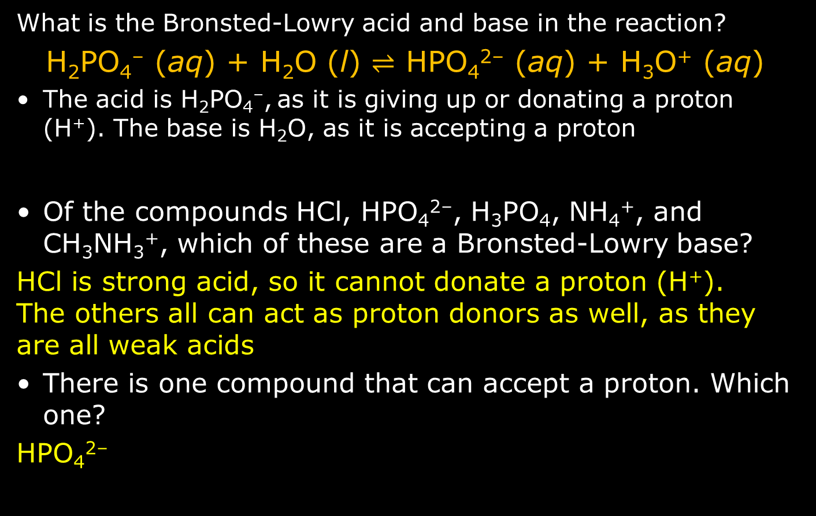
Practice
What is the Bronsted-Lowry acid and base in the reaction?
H₂PO₄– (aq) + H₂O (l) $⇌$ HPO₄^{2–} (aq) + H₃O⁺ (aq)
The acid is H₂PO₄–, as it is giving up or donating a proton (H⁺). The base is H₂O, as it is accepting a proton
Of the compounds HCl, HPO₄^{2–}, H₃PO₄, NH₄⁺, and CH₃NH₃⁺, which of these are a Bronsted-Lowry base?
HCl is strong acid, so it cannot donate a proton (H⁺). The others all can act as proton donors as well, as they are all weak acids
There is one compound that can accept a proton. Which one?
HPO₄^{2–}

Slide 21
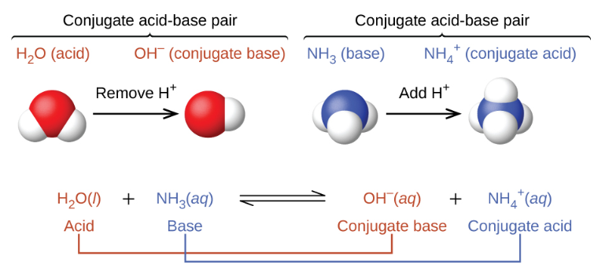
Conjugate Acid-Base Pair
conjugate: a substance formed by reversible combination of two or more others
When ammonia NH₃ is dissolved in water, H₂O will act as an acid in donating a proton the NH₃ acting as a base. This produces a conjugate base OH– and a conjugate acid NH₄⁺
The reverse reaction occurs as well, with NH₄⁺ acting as an acid (proton donor) and OH– acting as a base (proton acceptor). OH– is in fact a very strong base

Slide 22
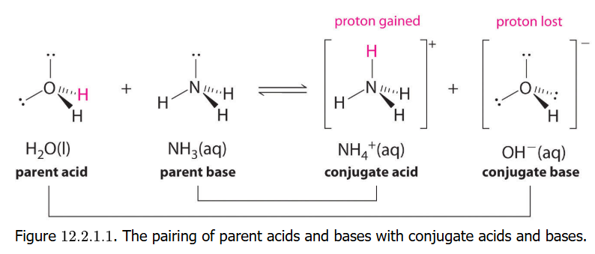
Acid-Base Reactions Forward and Reverse
Here’s another look at the NH3 in water reaction which shows how a proton (H+) bonds with a lone pair of electrons on the N atom, which is how these reactions usually occur

Slide 23
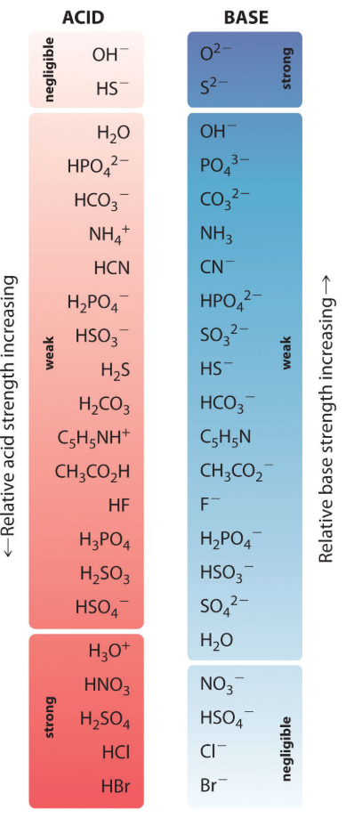
Strengths of Conjugate Pairs
The lists to the left show the known relative strengths of acids and bases. Note this list. Those compounds listed as weak make good buffers (to be discussed)
Look at the left side and the right side: these are the conjugate bases and acids

Slide 24

Practice: Conjugate Acid-Base Pairs
What are the conjugate acid-base pairs in this equilibrium reaction?
CH₃COOH + H₂O $⇌$ H₃O⁺ + CH₃COO–
What donates the proton? CH₃COOH
What accepts the proton? H₂O
Reactant: acid CH₃COOH (acetic acid)
Reactant: base H₂O (water)
Product: conjugate base CH₃COO– (acetate)
Product: conjugate acid H₃O⁺ (hydronium ion)

Slide 25
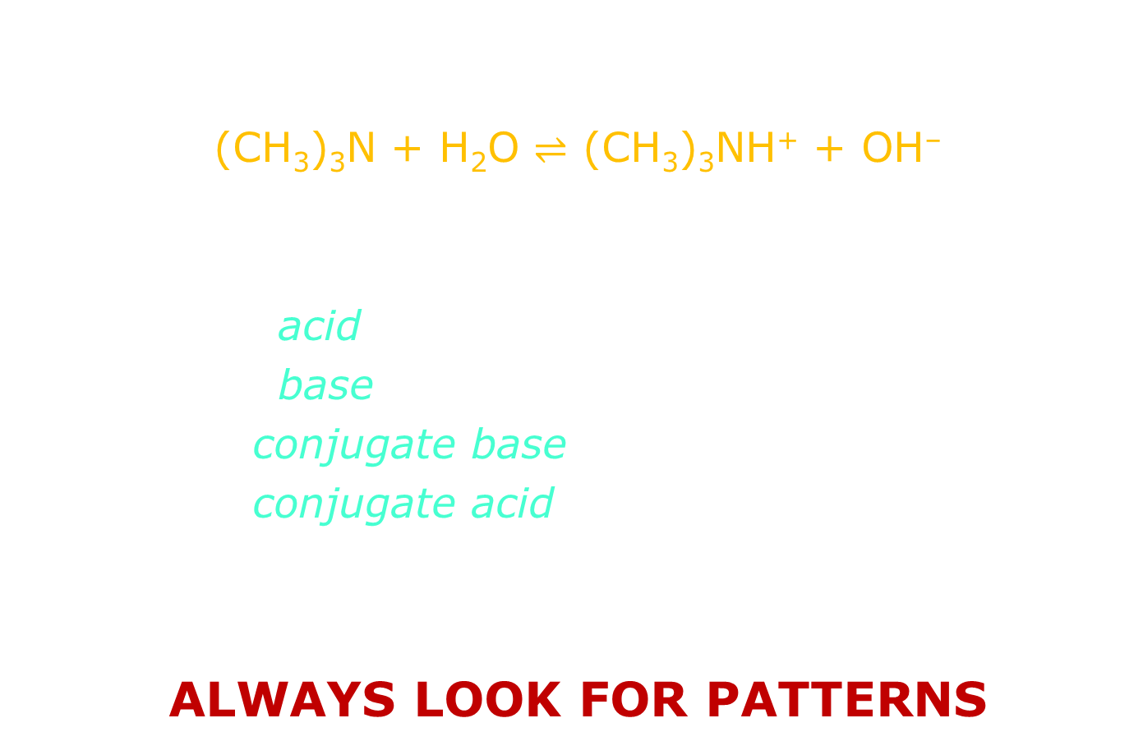
Practice: Conjugate Acid-Base Pairs
What are the conjugate acid-base pairs in this equilibrium reaction?
(CH₃)₃N + H₂O $⇌$ (CH₃)₃NH⁺ + OH–
What donates the proton? H₂O
What accepts the proton? (CH₃)₃N
Reactant: acid H₂O
Reactant: base (CH₃)₃N (trimethylamine)
Product: conjugate base OH– (hydroxide ion)
Product: conjugate acid (CH₃)₃NH⁺
Trimethylamine is just ammonia NH₃ with three methyl groups (CH₃–) instead of three hydrogen atoms, and if ammonia is a known base, so is TMA
ALWAYS LOOK FOR PATTERNS

Slide 26

Practice: Conjugate Acid-Base Pairs
What are the conjugate acid-base pairs in this equilibrium reaction? What looks like it needs a proton (H+ ion)? Look for where the movement transfer happens
NH₂– + H₂O $⇌$ NH₃ + OH–
What donates the proton? H₂O
What accepts the proton? NH₂–
Reactant: acid H₂O
Reactant: base NH₂–
Product: conjugate base OH–
Product: conjugate acid NH₃

Slide 27
Acid-Base Reactions: Neutralization
Neutralization is the classic acid-base reaction
The classic example of this type is a strong acid reacting with a strong base
HCl (aq) + NaOH (aq) → NaCl + H₂O (l)
Note that the arrow is forward, not the equilibrium arrow, because this reaction really goes 100%
Acid-base reactions occur in aqueous solutions so they form solvated ions. This is the complete ionic equation:
H⁺ (aq) + Cl– (aq) + Na⁺ (aq) + OH– (aq) → Na⁺ (aq) + Cl– (aq) + H₂O (l)
The net ionic equation shows the important effect:
H⁺ (aq) + OH– (aq) → H₂O (l)

Slide 28
Acid-Base Reactions: Neutralization
Propionic acid (CH₃CH₂COOH) will react with calcium hydroxide [Ca(OH)₂] to produce calcium propionate. What is the balanced chemical equation?
Here is the skeletal chemical equation:
CH₃CH₂COOH (aq) + Ca(OH)₂ (aq) → (CH₃CH₂COO)₂Ca (aq) + H₂O (l)
Here is the balanced chemical equation:
2 CH₃CH₂COOH (aq) + Ca(OH)₂ (aq) → (CH₃CH₂COO)₂Ca (aq) + 2 H₂O (l)

Slide 29
Acid-Base Reactions: Active Metals
Previously we discussed how solid pure elemental metals will react with strong acids in a single displacement reaction which is actually an oxidation-reduction (redox) reaction
Zn (s) + 2 HCl (aq) → H₂ (g) + ZnCl₂ (aq)
Certain metals will also react with bases also in a redox reaction and also producing hydrogen gas:
Zn (s) + 2 NaOH (aq) + 2 H₂O → Na₂Zn(OH)₄ (aq) + H₂ (g)

Slide 30
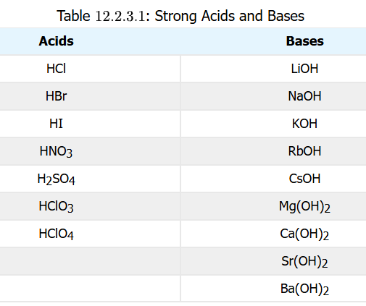
Strong / Weak Acids & Bases
Acids have a strength to them, with strength determined by whether they ionize in water (aqueous solution) completely (100%) or less than that
Strong acids and bases are those that dissociate (ionize) completely (100%) in aqueous solution
Weak acids and bases are those that dissociate (ionize) partially (less than 100%)

Slide 31
Practice: Strong & Weak
Strong or weak acid or base?
HCl
strong acid
Mg(OH)₂
strong base
C₅H₅N (pyridine)
weak base
RbOH
strong base
HNO₂
weak acid

Slide 32
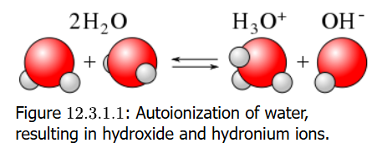
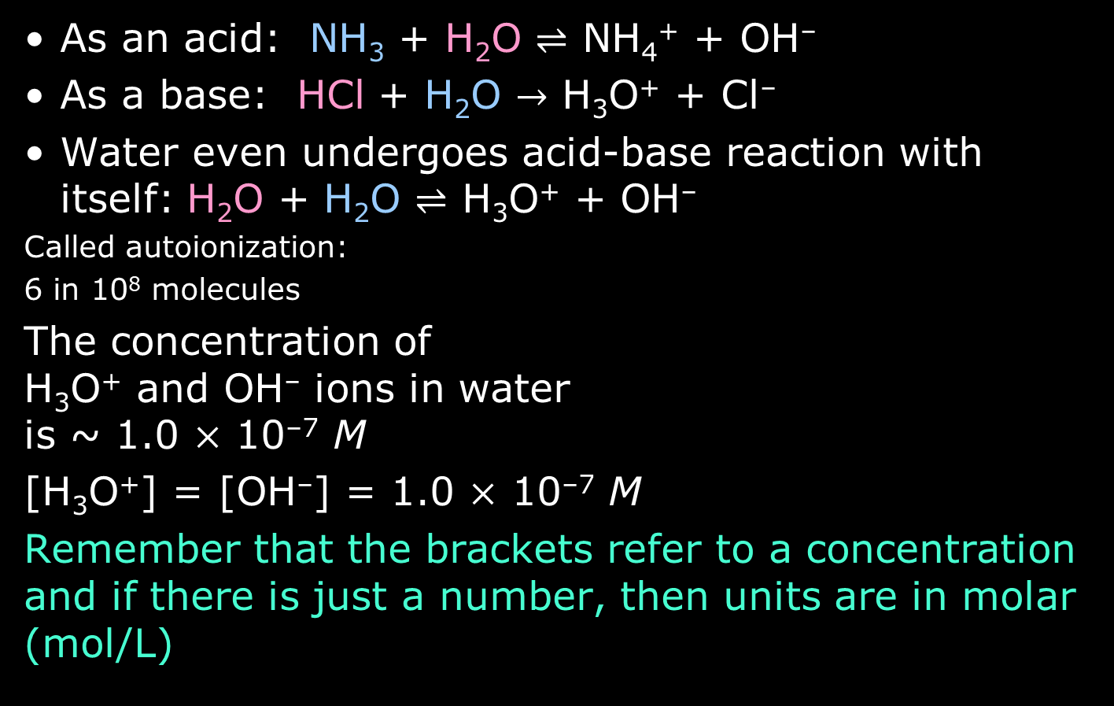
Water as an Acid and Base
As an acid: NH₃ + H₂O $⇌$ NH₄⁺ + OH–
As a base: HCl + H₂O $→$ H₃O⁺ + Cl–
Water even undergoes acid-base reaction with itself: H₂O + H₂O $⇌$ H₃O⁺ + OH–
Called autoionization:
6 in 10⁸ molecules
The concentration of H₃O⁺ and OH– ions in water is ~ 1.0 $×$ 10^{–7} M
[H₃O⁺] = [OH–] = 1.0 $×$ 10^{–7} M
Remember that the brackets refer to a concentration and if there is just a number, then units are in molar (mol/L)

Slide 33
K_{w} = [H₃O⁺][OH–] = 10^{–14}
The concentration of H⁺ (as H₃O⁺) and OH– ions in any aqueous solution can be understood as the product [H₃O⁺] x [OH–] = 10^{–14} (units are actually M²)
(the times symbol can be omitted)
This equation is the equilibrium constant for water, K_{w}: K_{w} = [H₃O⁺][OH–] = 1.0 × 10^{–14}
When a strong acid H₃O⁺ is added, the [H₃O⁺] goes up, OH– is consumed and [OH–] goes down
When a strong base OH– is added, the [OH–] goes up, H₃O⁺ is consumed and [H₃O⁺] goes down

Slide 34

Practice: K_{w} = [H₃O⁺][OH–] = 10^{–14}
Water is acidified such that [H₃O⁺] = 1.0 $×$ 10⁻⁴ M. What is [OH–]?
K_{w} = [H₃O⁺][OH–] = 10^{–14}
$$\text{[}\text{OH}\text{–}\text{]}\text{ = }\frac{K_{w}}{[H3O+]}\text{=}\frac{1.0 ×{10}^{−14} M2}{1.0 ×{10}^{−4} M}=1.0×{10}^{−10} M$$
Assuming both protons ionize, what is [OH–] of a 0.00032 M H₂SO₄ solution?
$$\text{[}\text{OH}\text{–}\text{] = }\frac{K_{w}}{[H3O+]}\text{=}\frac{1.0 ×{10}^{−14} M2}{6.4 ×{10}^{−4} M}=1.6×{10}^{−11} M$$
Note concentration converted to scientific notation

Slide 35

Practice: K_{w} = [H₃O⁺][OH–] = 10^{–14}
Water is acidified such that [H₃O⁺] = 1.0 $×$ 10⁻⁴ M. What is [OH–]?
K_{w} = [H₃O⁺][OH–] = 1.0 × 10^{–14}
$$\text{[}\text{OH}\text{–}\text{]}\text{ = }\frac{K_{w}}{[H3O+]}\text{=}\frac{1.0 ×{10}^{−14} M2}{1.0 ×{10}^{−4} M}=1.0×{10}^{−10} M$$
Assuming both protons ionize, what is [OH–] of a 0.00032 M H₂SO₄ solution?
$$\text{[}\text{OH}\text{–}\text{] = }\frac{K_{w}}{[H3O+]}\text{=}\frac{1.0 ×{10}^{−14} M2}{1.0 ×{10}^{−4} M}=1.0×{10}^{−10} M$$

Slide 36
pH Defined
Writing out [H₃O⁺] = 1.45 x 10^{–8} M for chemists can lead to a kind of eye strain and brain punch
So they came up with a convenient conversion
pH = –log [H₃O⁺] also written pH = –log [H⁺]
Recall that water with no added acid or base has a [H₃O⁺] = 1.0 × 10^{–7} M. The pH would be:
pH = –log (1.0 × 10^{–7}) = 7.0
You can also compute that if acid is added, the pH will be less than 7.0; if base added, pH greater than 7.0
The pH scale will go from 0 to 14, in fact

Slide 37
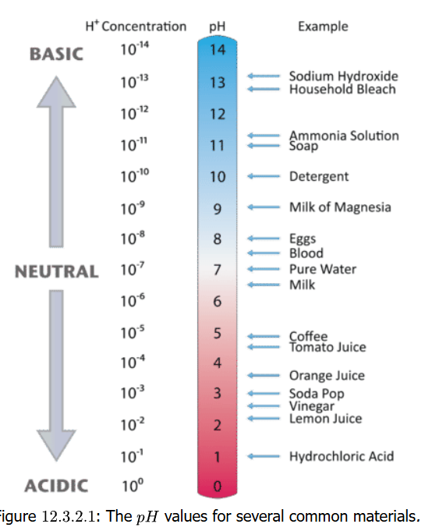
The pH Scale
Acidic, basic or neutral?
milk of magnesia, pH 10.5
basic
pure water, pH 7.0
neutral
wine pH 3.0
acidic
human blood, pH 7.4
basic (slightly)
ammonia, pH 11.0
basic
cherries pH 3.6
acidic

Slide 38
The Math of pH
You should be able to calculate pH from [H₃O⁺] and [H₃O⁺] from pH
What is the pH if [H₃O⁺] = 1 × 10⁻³ M?
pH = –log [1 × 10⁻³] = 3.0
What is the pH if [H₃O⁺] = 2.5 × 10⁻¹¹ M?
pH = –log [2.5 × 10⁻¹¹] = 10.60
What is the pH if [H₃O⁺] = 4.7 × 10⁻⁹ M?
pH = –log [4.7 × 10⁻⁹] = 8.30
a.bbb (pH) → b.bb x 10ª
Note how significant digits work in this conversion
Backconversion: [H₃O⁺] = antilog(–pH) = 10^{–pH}
You have a solution at pH = 8.3. What is [H₃O⁺]?
[H₃O⁺] = 10^{–pH =} 10^{–8.3} = 5.0 x 10⁻⁹ M

Slide 39
pOH
Just as pH = – log [H⁺], pH = –log [OH–]
Since K_{w} = [H₃O⁺][OH–]
Take negative logarithm of both sides:
– log K_{w} = –log [H₃O⁺][OH–]
– log K_{w} = –log [H₃O⁺] + –log[OH–]
pK_{w} = pH + pOH
Since K_{w} = 1.0 × 10^{–14} (at 25°C)
Then 14.00 = pH + pOH
If the pH = 4.42, what is the pOH?
14.00 = pH + pOH
pOH =14.00 – 4.42 = 9.58

Slide 40
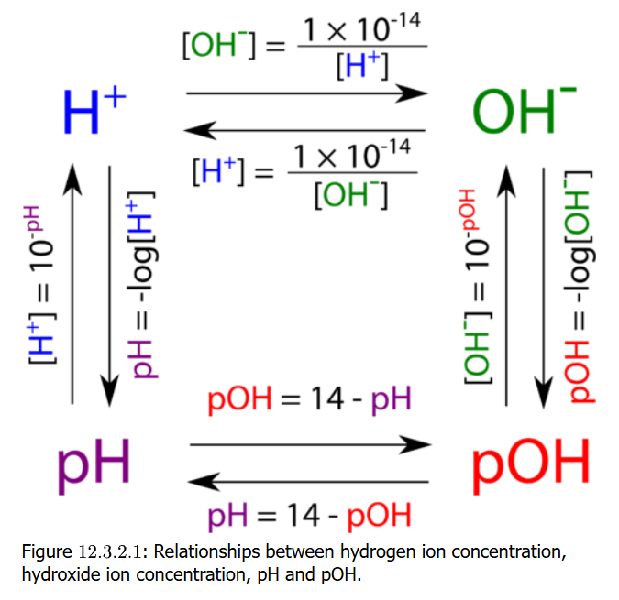
Relating pH to pOH and [ ]
This shows you how to convert [H⁺] and [OH–], and to pH and pOH
It’s easy after an hour of practice (or less)

Slide 41
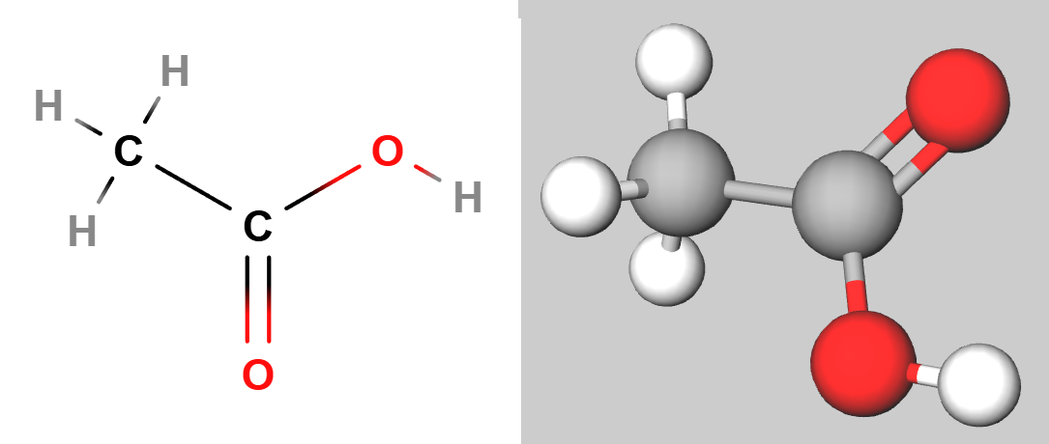
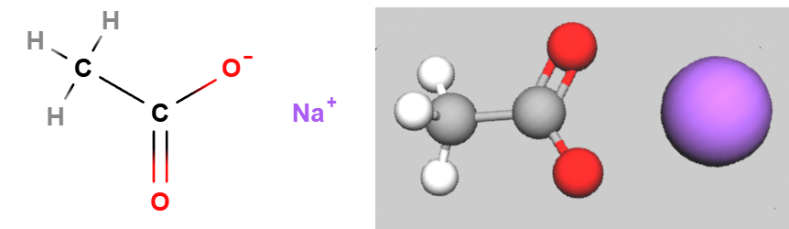
Buffers: Resisting pH Change
The acid of the stomach is the strong acid hydrochloric acid (HCl). Its concentration is estimated to be 0.05 M. If 1 mL got into the blood, the blood pH would go from 7.4 to about 4.9, with fatal results.
Buffers are made of weak acid or weak base along with salt of its conjugate base or conjugate acid.
An example of a buffer is acetic acid and sodium acetate, detailed on the next slide

Slide 42
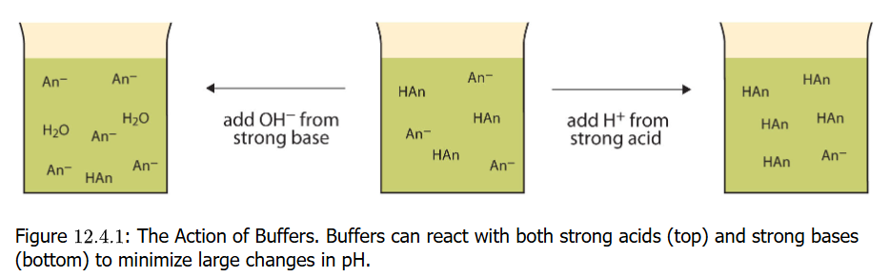
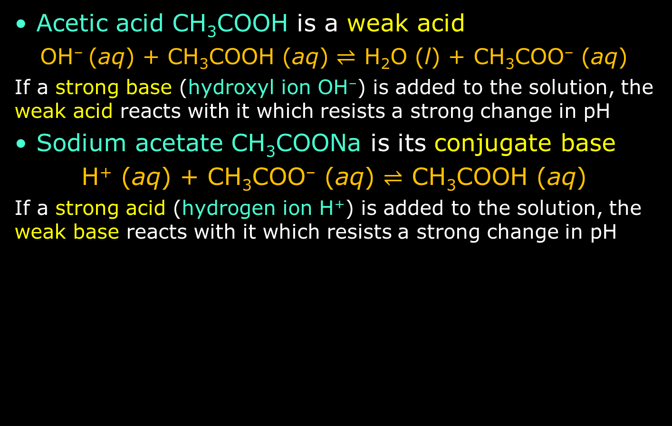
Mechanism of Buffering
Acetic acid CH₃COOH is a weak acid
OH– (aq) + CH₃COOH (aq) $⇌$ H₂O (l) + CH₃COO– (aq)
If a strong base (hydroxyl ion OH–) is added to the solution, the weak acid reacts with it which resists a strong change in pH
Sodium acetate CH₃COONa is its conjugate base
H⁺ (aq) + CH₃COO– (aq) $⇌$ CH₃COOH (aq)
If a strong acid (hydrogen ion H⁺) is added to the solution, the weak base reacts with it which resists a strong change in pH

Slide 43
Practice: Buffers
Are these solute combinations good aqueous buffers?
HCOOH + Na^{+ –}OOCH
Yes -- Formic acid: weak acid; sodium formate: its conjugate base as a salt
HCl + NaCl
No -- Hydrochloric acid is a strong acid, not weak; not a good buffer
CH₃NH₂ + CH₃NH₃⁺ Cl–
Yes -- Methylamine is just the methyl derivative of ammonia, which is a known weak base. Its chloride is a conjugate acid
NH₃ + NaOH
No – While ammonia is a weak base, the other solute should be a conjugate acid, like ammonium chloride or sulfate, not a strong base like sodium hydroxide

Slide 44
Practice: Buffers
Are these solute combinations good aqueous buffers?
NaHCO₃ + NaCl
No – While sodium bicarbonate is a good weak base, its conjugate acid is carbonic acid H2CO3 should be the other solute. Sodium chloride is not a weak acid or weak base
H₃PO₄ + NaH₂PO₄
Yes – Phosphoric acid and its conjugate base sodium dihydrogen phosphate make an excellent buffer
NH₃ + (NH₄)₃ PO₄
Yes – Ammonia is a weak base and ammonium phosphate is a conjugate acid that also includes a phosphate counterion that is itself a buffering chemical
NaOH + NaCl
No – Neither strong base sodium hydroxide or sodium chloride (not acid nor base) have properties as a weak acid or base required to be a buffering agent

